Slide 1

Modeling Total Personal Income in the U.S. Using 2023 ACS Data
A Predictive Analysis of Labor and Housing Market Determinants
Presented by
Misheck Malangano
Date: May 5, 2025

Slide 2
Project Overview
Objective: Predict and explain variations in total personal income (inctot)
Dataset: 2023 American Community Survey (ACS)
Population: U.S. residents aged 18–64
Outcome: Total Personal Income (continuous)
Methods: Descriptive analytics + Linear regression + Feature selection

Slide 3
Why Total Income?
Income is a key socioeconomic indicator
Continuous nature enables linear regression
Reflects education, work hours, race, etc.
Yields insights into policy and regional planning

Slide 4
Data Preparation
Handled missing values (9999999)
Filtered to working-age adults (18–64)
Re-coded categorical variables (e.g., sex, educ, race)
Created simplified variables and mapped state names

Slide 5
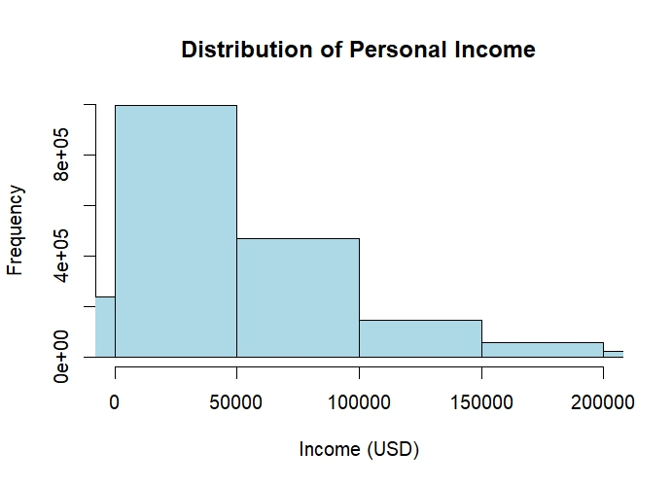
Income Distribution
Raw income: Right-skewed distribution

Slide 6
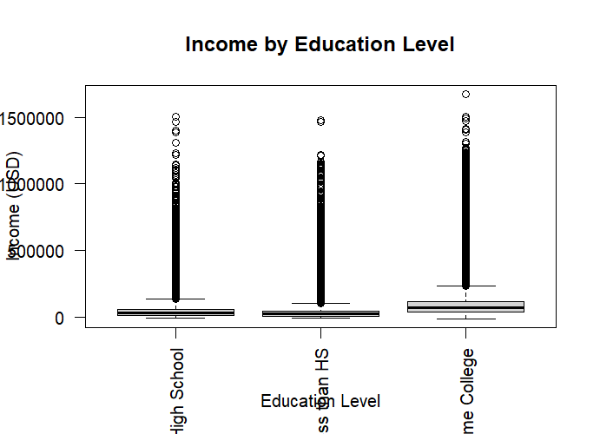
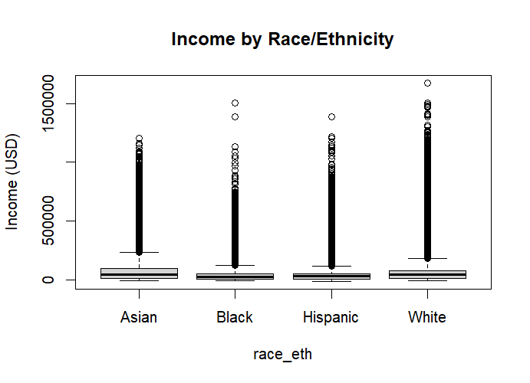
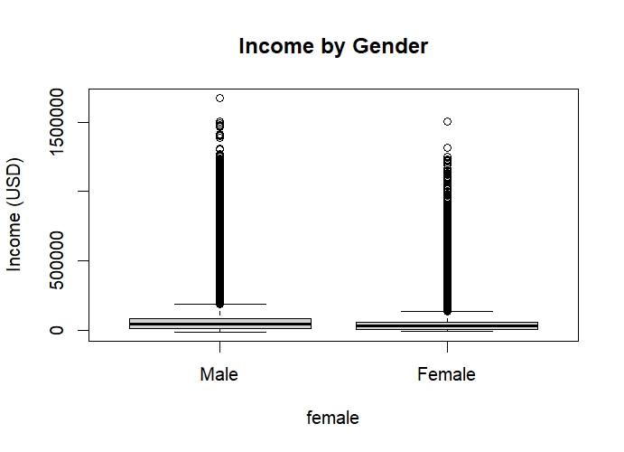
Demographic Patterns
Gender: Males earn more on average
Education: Higher education = higher income
Race/Ethnicity: Persistent disparities observed.

Slide 7
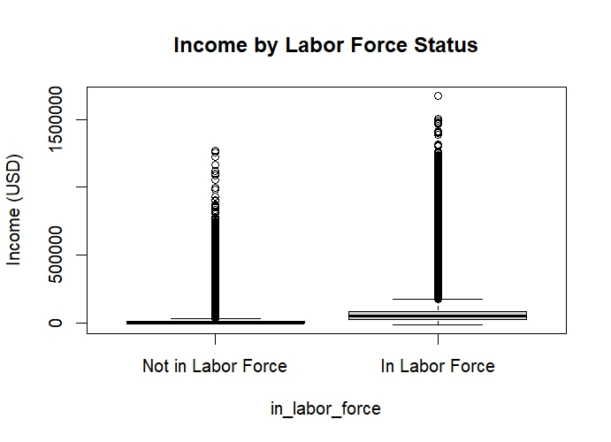
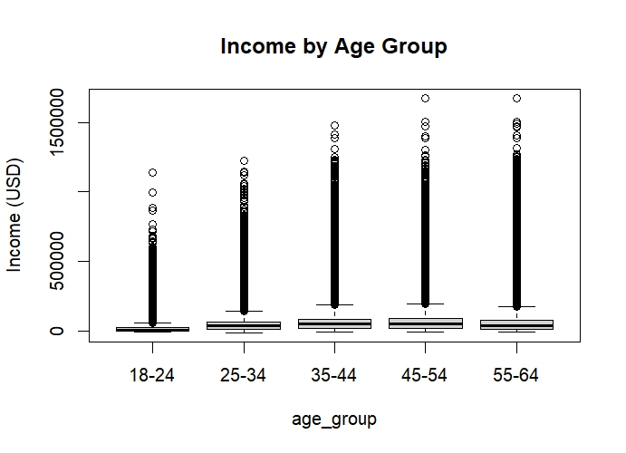
Additional Factors
Age: Peak income at mid-career (35–54)
Labor Force Participation: Strong income association

Slide 8
Predictive Modeling Steps
80% training, 20% testing split
Model 1: Age only
Model 2: Age, sex, hours worked
Model 3: Adds education, race
Final Model: Adds marital status, homeownership

Slide 9
Final Model Results
Test RMSE: ~$34,000
Test R-squared: ~45%
Top Predictors: Education, age, work hours, race, ownership
Visual: Predicted vs Actual Income Scatterplot

Slide 10
Key Insights
Education: Strongest predictor of income
Demographic gaps persist
Work intensity highly predictive
Model explains ~40–50% of variance

Slide 11
Why This Matters
Policy: Targeted economic programs
Business: Market segmentation use
Personal: Guides educational/career choices
Methodology: Demonstrates applied modeling + CV

Slide 12
Limitations & Next Steps
Omitted: Occupation, industry, cost of living
Top-coding affects income distribution
Future: Clustering, non-linear models, expanded variables

Slide 13
Thank You

